Slide 1

VIRTUAL MOUSE USING HAND GESTURE
Team Members: Supervisor:
NIRANJAN S (621320205033) Dr. N. MAGENDIRAN, M.E., Ph.D., Prof/IT
DINESH KUMAR M (621320205301)
RAHUL CR (621320205045)
Date:

Slide 2
TABLE OF CONTENTS
S.NO | TOPICS | PAGE NO
1 | ABSTRACT | 3
2 | INTRODUCTION | 5
3 | LANGUAGE USED IN PROJECT | 6
4 | SYSTEM REQUIREMENTS | 7
5 | EXISTING SYSTEM | 8
6 | PROPOSED SYSTEM | 9
7 | ALGORITHMS | 10
8 | SYSTEM ARCHITECTURE | 11
9 | MODULES | 12
10 | OUTPUT | 16
11 | CONCLUSION | 17
12 | REFERENCE | 18

Slide 3
ABSTRACT
A virtual mouse using hand gestures to control the mouse cursor and perform tasks on the computer is known as a virtual mouse.
This interface is designed to provide users, especially those with physical limitations or those who prefer a hand-free approach, a straightforward and natural method to interact with computers.
This technology uses a camera to record the user's hand movements.

Slide 4
CONT……
The computer performs the appropriate operations after processing the collected photos to identify the hand motions.
Machine learning methods have been utilized by the system to recognize and learn various hand motions.
NumPy, math, wx, and the mouse will be required to implement this system. The capacity to regulate a computer using hand gestures.

Slide 5
INTRODUCTION
Virtual mouse using hand gesture system that allows users to control the movement and actions of a computer mouse using hand movements and gestures.
The system uses a camera or sensor to track hand movements and translate them into mouse movements on the computer screen.
Hand gestures can be used to perform various mouse actions such as clicking, scrolling, and dragging.
The introduction of a virtual mouse has enhanced tracking accuracy, responsiveness, hand gesture detection, and machine learning algorithms.

Slide 6
LANGUAGE USED IN PROJECT
FRONT END
Camera view
BACK END
python

Slide 7
SYSTEM REQUIREMENTS
HARDWARE REQUIREMENT:
8 GB RAM
256 GB SSD
SOFTWARE REQUIREMENT:
Window 11
Visual studio code

Slide 8
EXISTING SYSTEM
The existing system of virtual mouse using hand gesture consists of the simple mouse operations using the hand recognition system, where we could perform the basic mouse operation like mouse pointer control, left click, right click, drag etc.
disadvantages
• Limited Accuracy
• Limited Gesture Recognition
• Limited Compatibility

Slide 9
PROPOSED SYSTEM
Gesture recognition software can be used to interpret hand movements and translate them into mouse actions, with the help of machine learning algorithms to improve accuracy and responsiveness over time.
Users can customize hand gestures to perform different mouse actions, such as assigning specific hand movements for clicking, scrolling, and dragging.

Slide 10
ALGORITHM
1. CONVOLUTIONAL NEURAL NETWORK(CNN)
It recognize patterns and features in images and videos
HAAR-CASCADE CLASSIFIER
It can detect specific features like edges, corners, and contours in an image.
STEP 1: Importing OpenCV
STEP 2: Importing XML file
STEP 3: Importing test Image
STEP 4: Converting the image to greyscale
STEP 5: Detecting Multi-scale hands
STEP 6: Mentioning sides of the rectangle for detection
STEP 7: Displaying the detected image

Slide 11
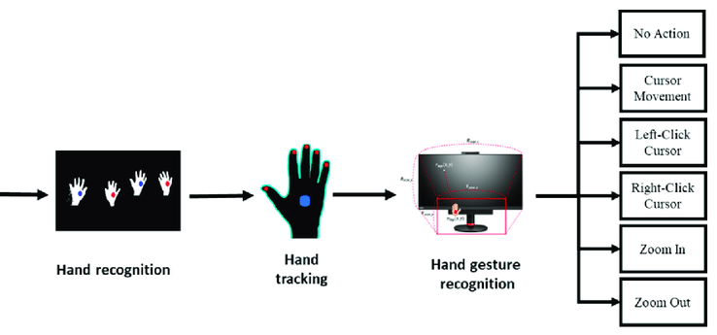
SYSTEM ARCHITECTURE

Slide 12
MODULES
The modules that may be included in a virtual mouse using hand gesture recognition system
Camera or sensor array module
Preprocessing module
Gesture recognition module
Virtual mouse control module
User interface module
Calibration module

Slide 13
Cont…
camera or sensor array module
The camera module is responsible for taking images of the user's hand movements and turning them into data the system can use. Depending on the complexity of the system, it may consist of a single camera or more than one of cameras.
2. Preprocessing module
The preprocessing module is responsibility for enhancing the relevant aspects of the hand movements and removing noise from the images that were captured by the camera or sensor array. Typically, image processing methods like filtering and segmentation are used for this module.

Slide 14
Cont…
3. Gesture recognition module
The user's hand gestures are captured by the Recognition module, which converts them into virtual mouse commands. To organize the movements and produce the relevant mouse commands, it may use rule-based systems or machine learning techniques.
4. Virtual mouse control module
The virtual mouse module converts gesture recognition module generated virtual mouse commands into actions that a computer or other electronic device recognizes. As well as keyboard inputs, it may include creating mouse movements and clicks.

Slide 15
Cont…
5. User interface module
The interface module provides the user a visual interface that shows the simulated mouse motions and enables system interaction. Additionally, it might have options for adjusting the parameters for the virtual mouse control and gesture recognition.
6. Calibration module
The user can adjust the device to their specific hand movements and preferences using the calibration module. This may consist of executing a series of predefined gestures to train the system on the user's hand motions or changing various settings to enhance the operation of the system.

Slide 16
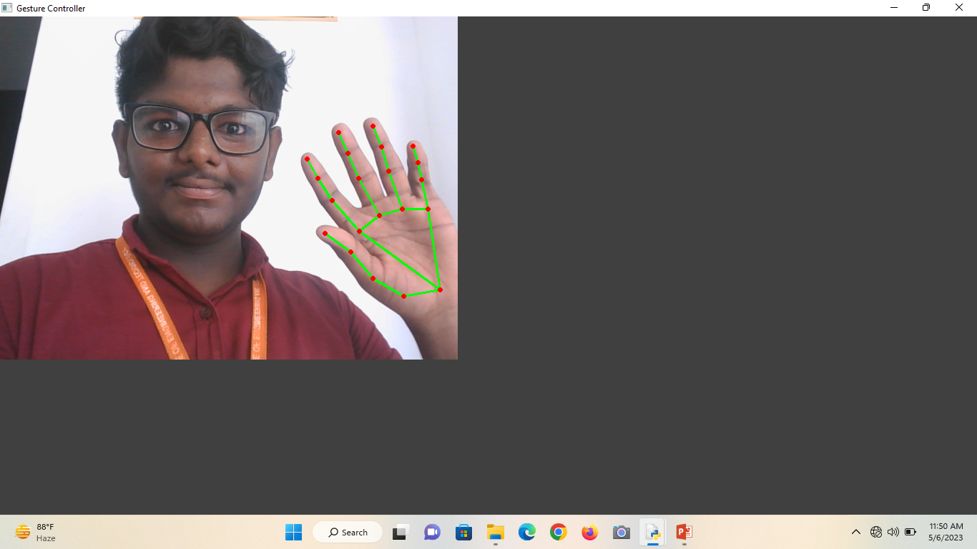
OUTPUT

Slide 17
CONCLUSION
virtual mouse using hand gestures can be achieved by training a machine learning model to recognize specific hand gestures, detecting and tracking the movement of the hand in real-time using computer vision techniques, and mapping those gestures to specific mouse actions. The algorithms will depend on the specific requirements and constraints of the application.
Design and testing, a virtual mouse system that responds to hand gestures can provide an intuitive and convenient way to control a computer without the need for a physical mouse or touchpad.

Slide 18
REFERENCE
[1] Banerjee, A., Ghosh, A., Bharadwaj, K., & Saikia, H. (2014). Mouse control using a web camera based on color detection. arXiv preprint arXiv:1403.4722.
[2] Niyazi, K. (2012). Mouse Simulation Using Two Colored Tapes. International Journal of Information Science and Technology, 2(2), 57-60.
[3] Zhengyou, Z., Ying, W. and Shafer, S. (2001). Visual Panel: Virtual Mouse, Keyboard and 3D Controller with an Ordinary Piece of Paper. In Proceedings of the 2001 IEEE Symposium on Visual Languages and Human-Centric Computing (pp. 171-172).

